Slide 1

Cooler Cooler Cooler
Team: Joshua Brull, Matt Demchuk, Jovanni Rodriguez, Kai Xu
Notes:
Add dimensions
Add

Slide 2
Planning
Implementation
Test/Troubleshoot
Final Iteration
Problem
Solution
Original Goals
Design
Data Diagram
Chassis
Wiring
Arduino Modules
Axis Module
Application
Motor Issues
Redesign
Final Assembly
ArduinoBlue
Demo
Notes:
Matt

Slide 3
Part 1. Plan and Designs
Notes:
Matt

Slide 4


Problem
Trips to the beach often require carrying lots of bags, chairs, mats, lunchboxes, etc.
This can make going to and from the beach quite a hassle
Notes:
Matt

Slide 5
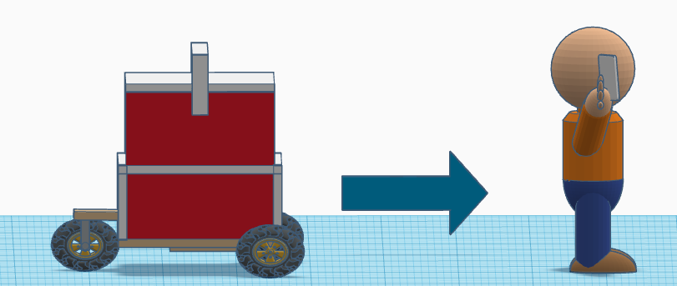
Solution
A cooler that carries its own weight
Specifically, an unmanned cooler which follows the user autonomously
Follows via GPS location of user’s mobile device
Notes:
Josh

Slide 6
Original Goals
Autonomous system
Carry up to 50 lbs
Speeds from 3-5 mph
Easy to use application
Works well on sandy terrain
Notes:
Josh

Slide 7
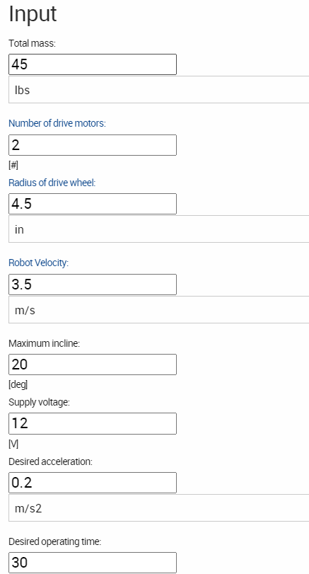
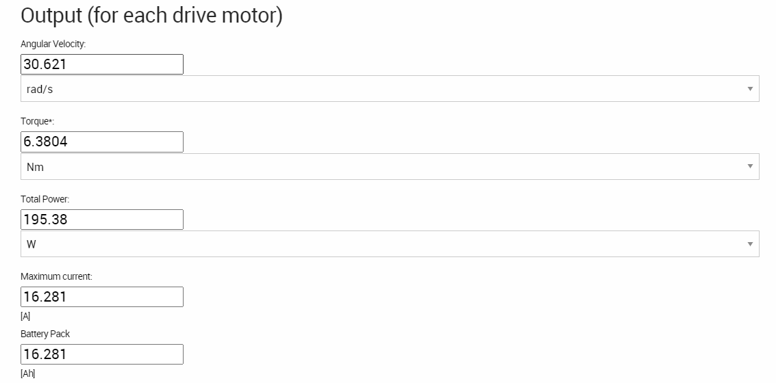
Motor Selection
Motor requirements:
Enough torque to carry 50 lbs
Enough RPM to allow 9 inch wheels to travel at 3 mph
Take up reasonable portion of the budget
https://www.robotshop.com/community/blog/show/drive-motor-sizing-tool
Notes:
Josh

Slide 8
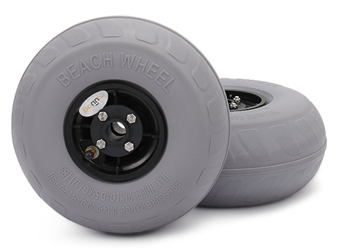

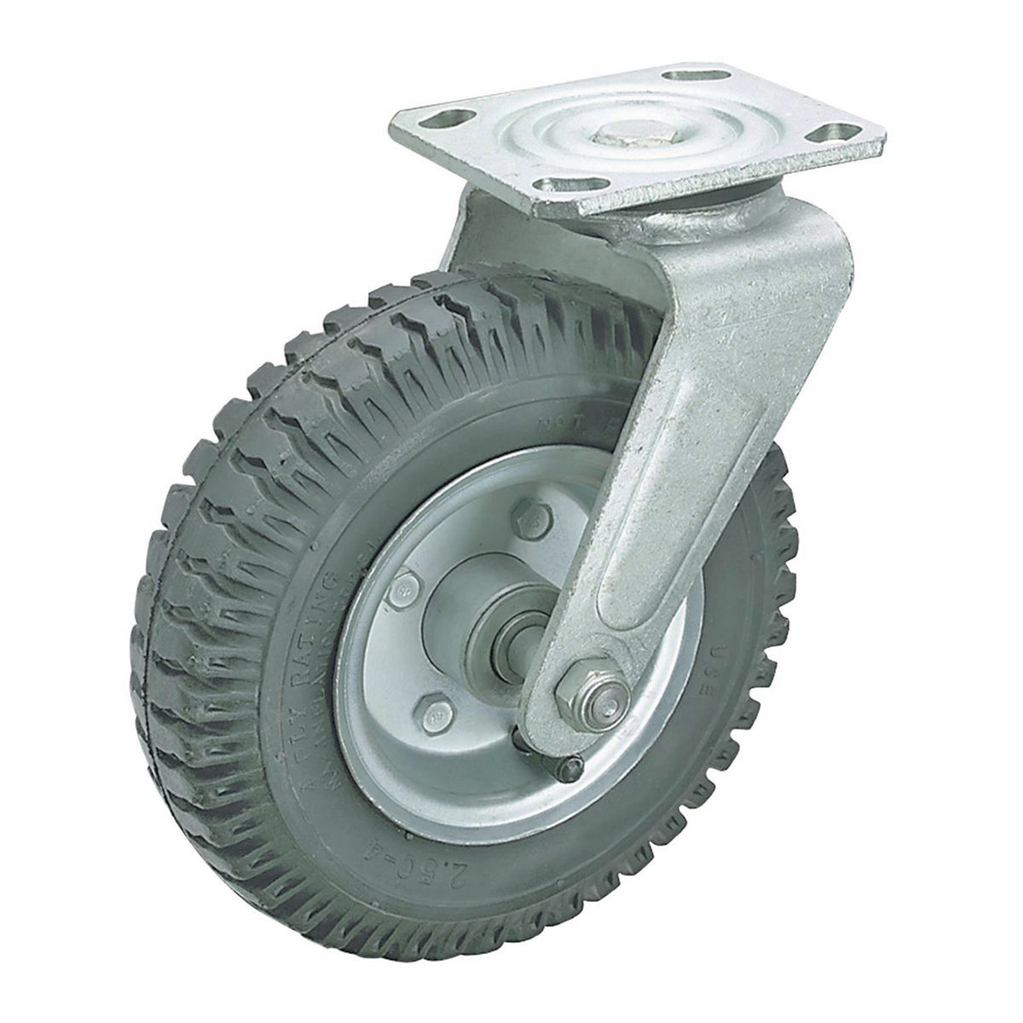
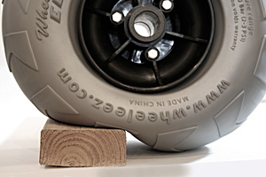
Wheel Selection
Beach Wheels
Low tire pressure and lots of surface area
Large enough to keep base out of dips
Low psi (3) and soft, so they fit the shape of the sand and distribute the load over a wide surface
Caster
Notes:
What are the benefits and drawbacks of the beach wheels? Also mention the caster
https://wheeleez.cn/about-low-pressure-wheels.php
Josh

Slide 9
Part List
Part | Amount
12V DC Motors | 2
HM10 Bluetooth Module | 1
HMC5883L Axis Module | 1
GPS Module | 1
Beach Tires | 2
Caster Wheel | 1
Arduino Uno | 1
L298N Motor Driver | 1
Notes:
Jovanni

Slide 10
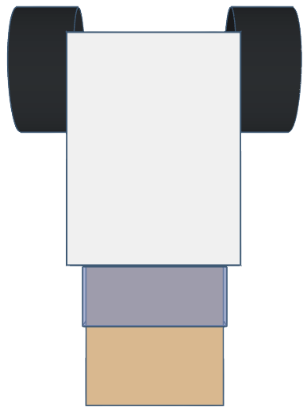
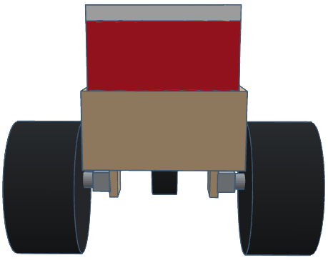
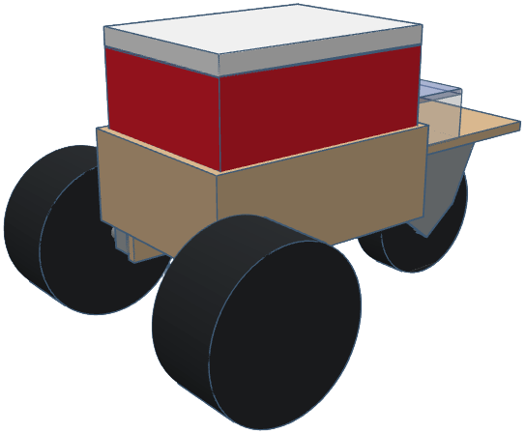
Chassis Design
Front
Top
Angled
Notes:
Add dimensions
Matt

Slide 11
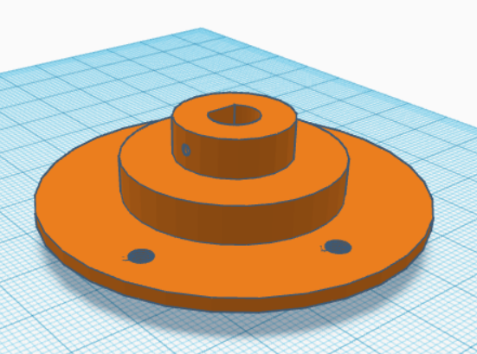
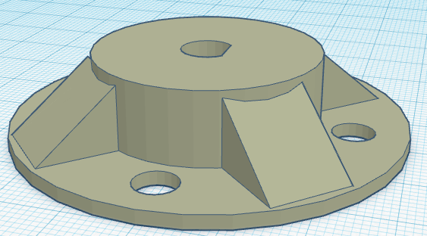
Motor Mount Design
Connects the motor shaft to the wheel
Support the weight of the chassis
40%infill —> 60% infill
Notes:
Kai
Goal
problem
How can we strengthen it

Slide 12

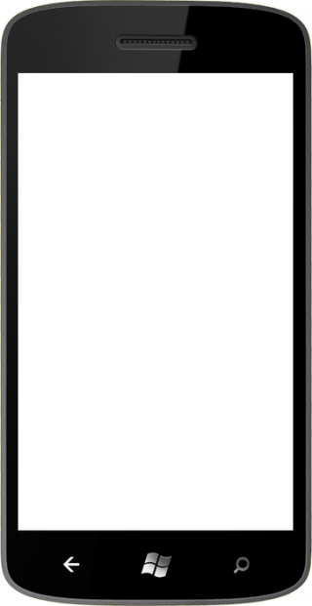
System Diagram (autonomous tracking system)
Notes:
Jovanni

Slide 13
Data Diagram
Coolers GPS coordinates
L Motor
Application
Arduino
GPS Module
Turning Angle
on/off/reverse
1.
GPS Unit
Bluetooth Module
Motor Driver
Autonomous Navigation Algo
Distance between points
2.
on/off/reverse
Axis Module
R Motor
Phone GPS Coordinates
Coolers Angle from North
Notes:
Jovanni

Slide 14
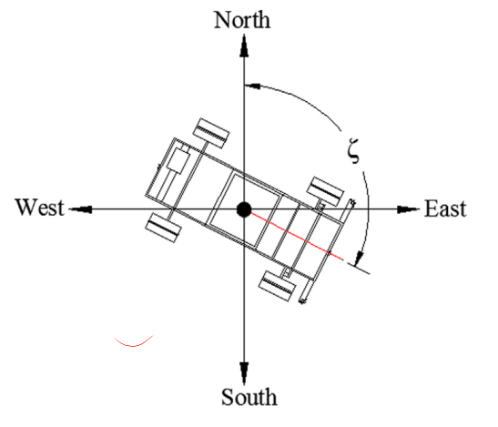
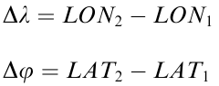
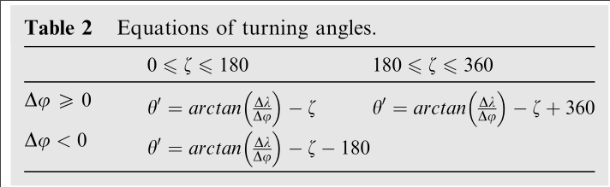
Autonomous Navigation Algorithm
1. Calc Heading Angle
1.
Use the axis module to calculate the heading angle based on North.
5. Move to Coordinate
2. Calc delta lat/lon
Drive forward until Cooler’s coordinates match phone’s sent coordinates.
Calculate difference in longitude and latitude between phone and cooler.
2.
4. Face correct direction
3. Calc turn angle
3.
Turn until facing given phone coordinate.
Calculate turning angle using table, basing on previous values.
Notes:
Jovanni

Slide 15
Part 2. Implementation
Notes:
Matt

Slide 16
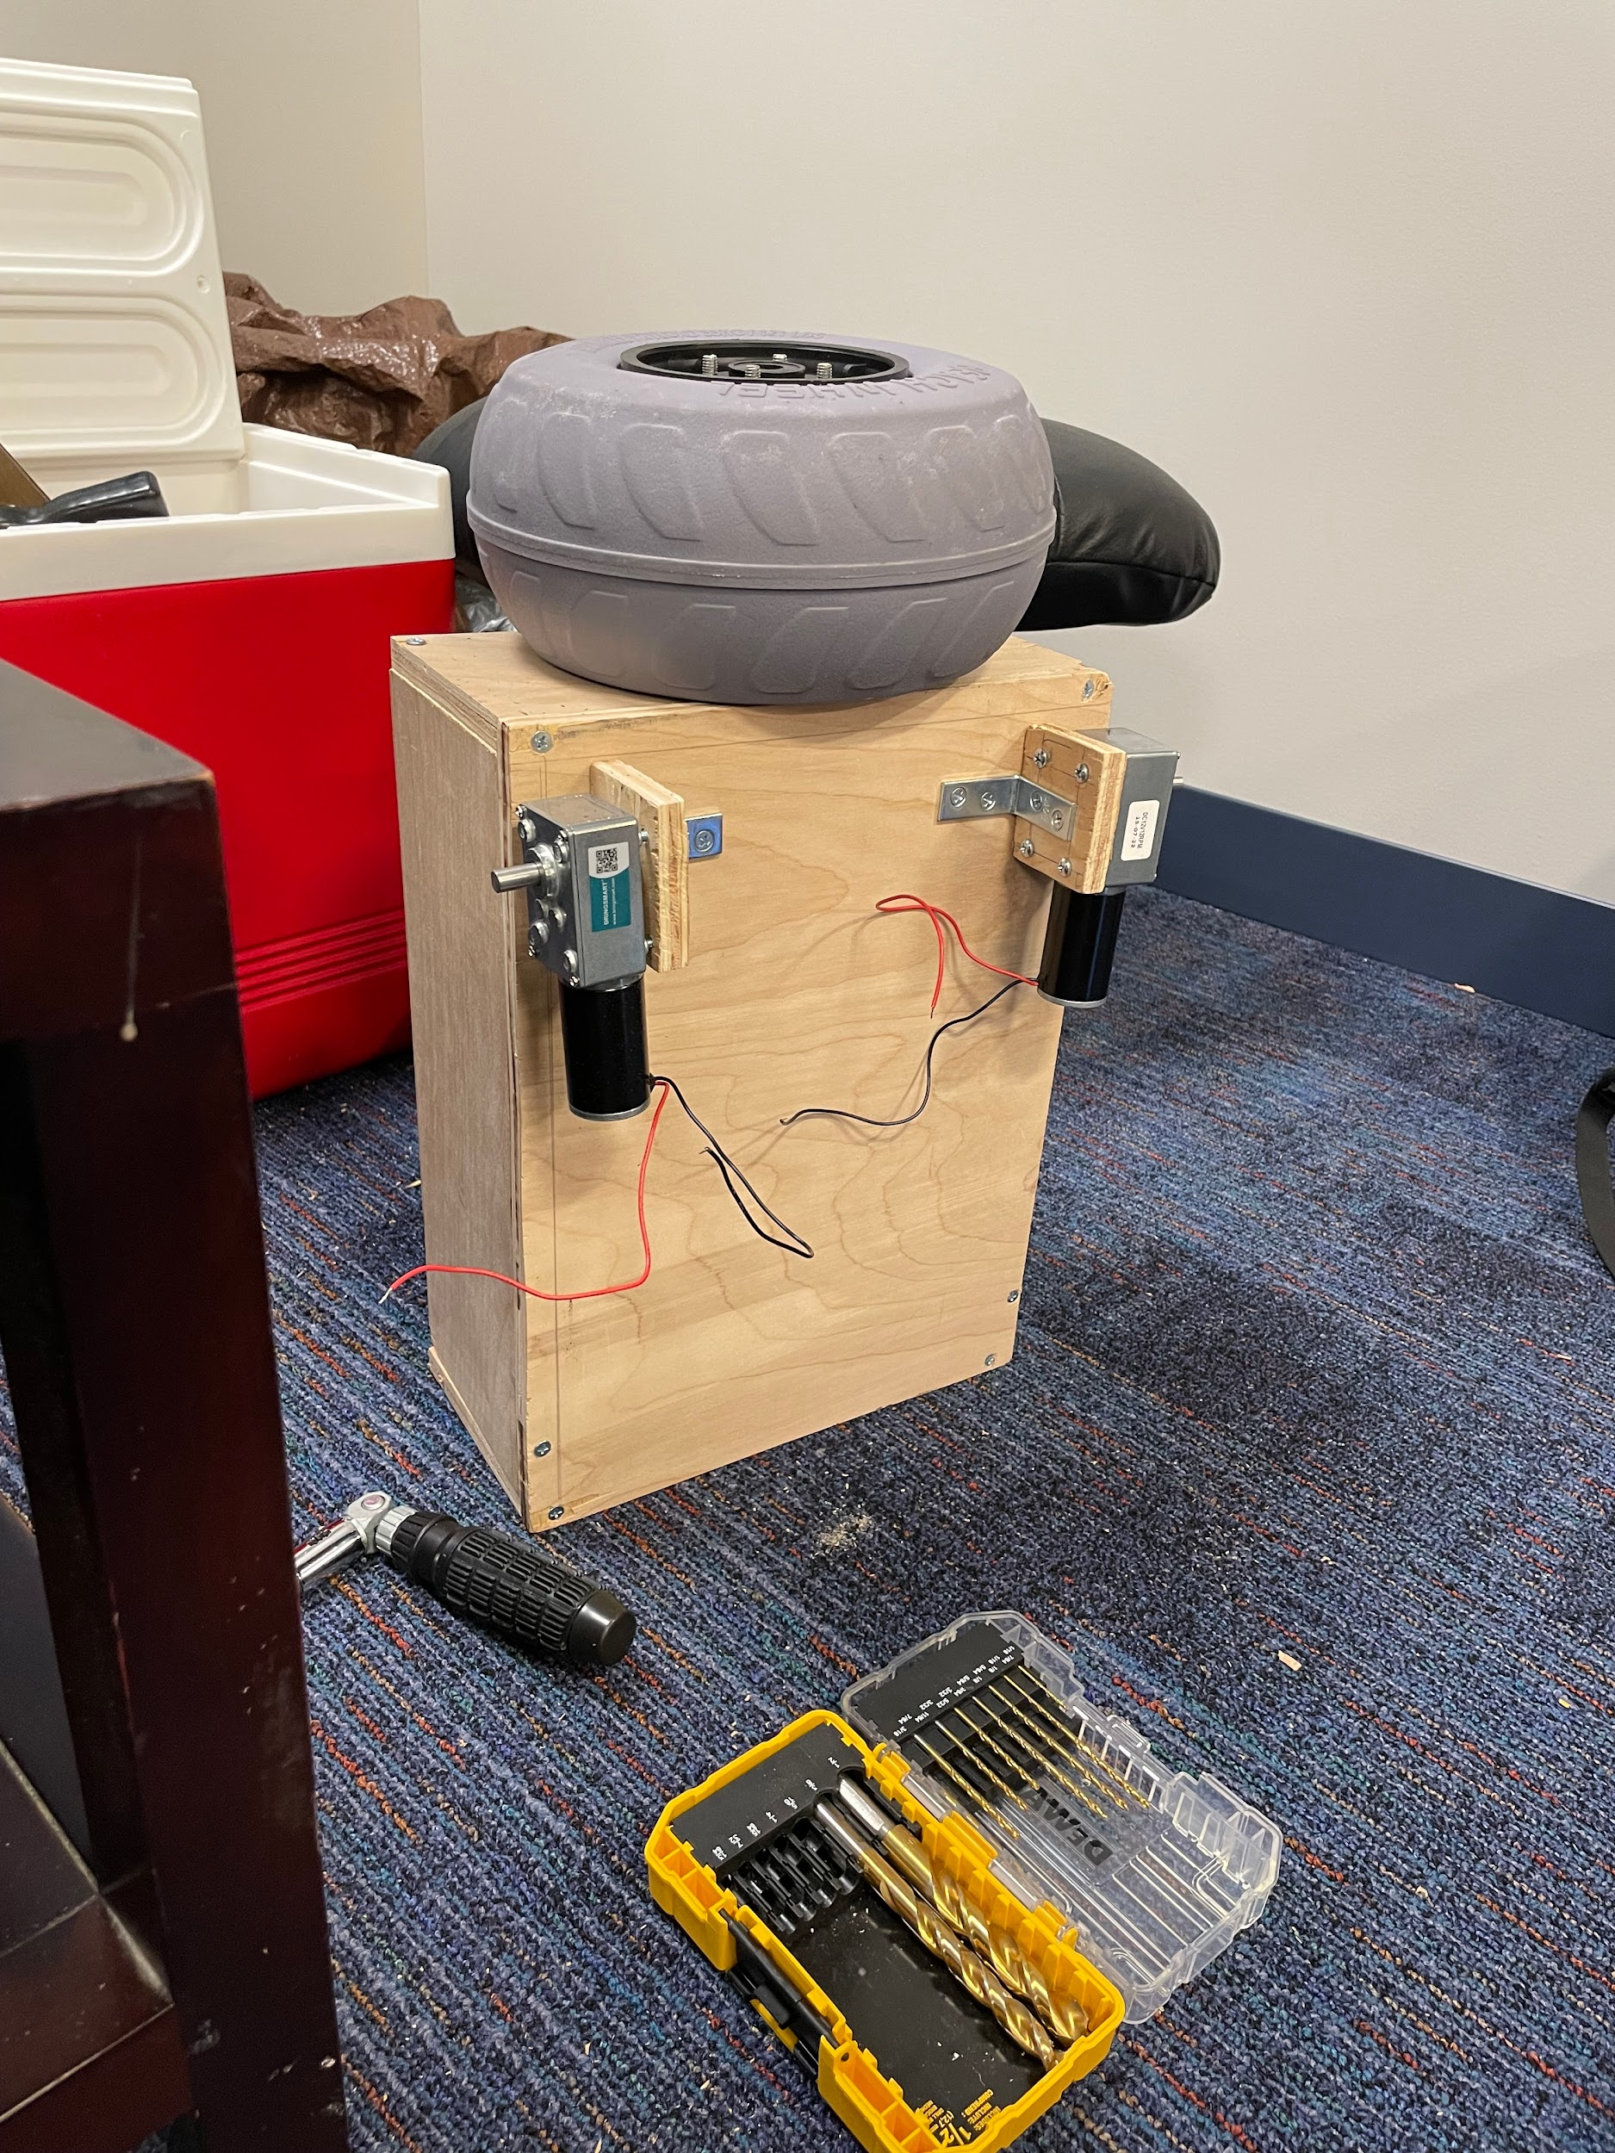
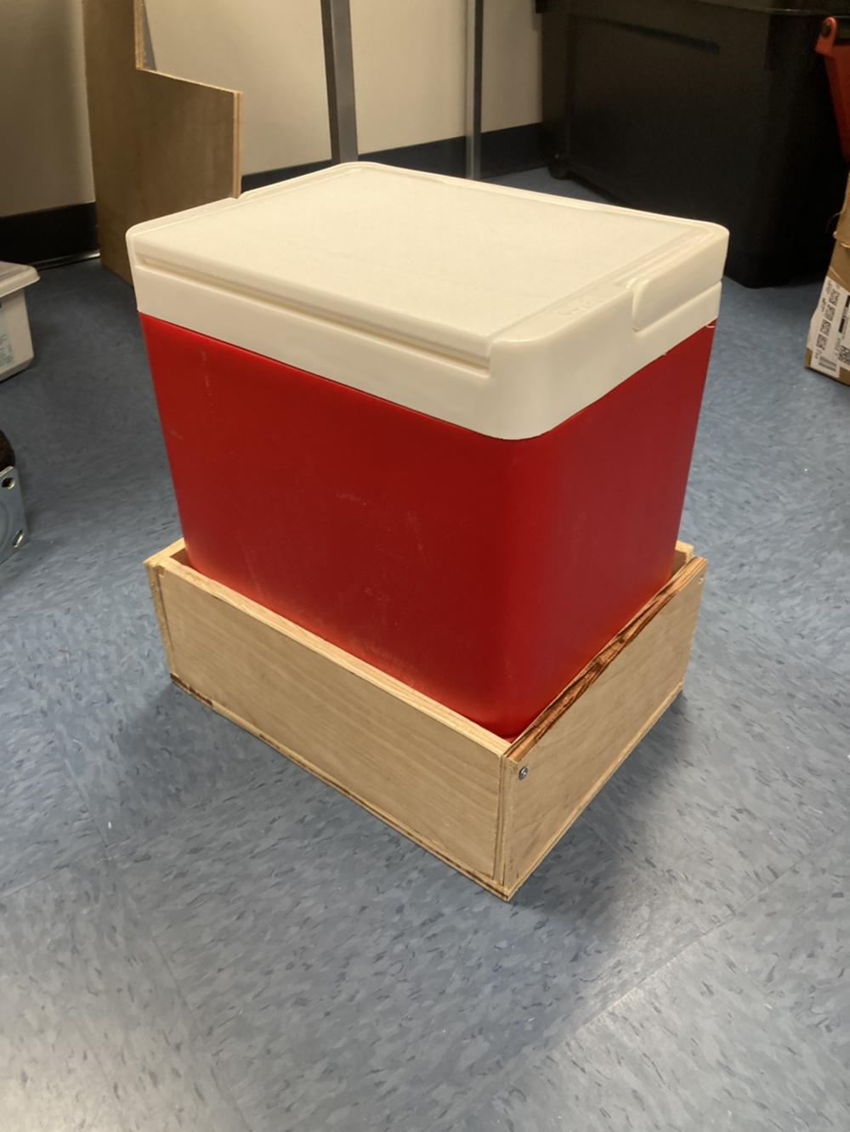
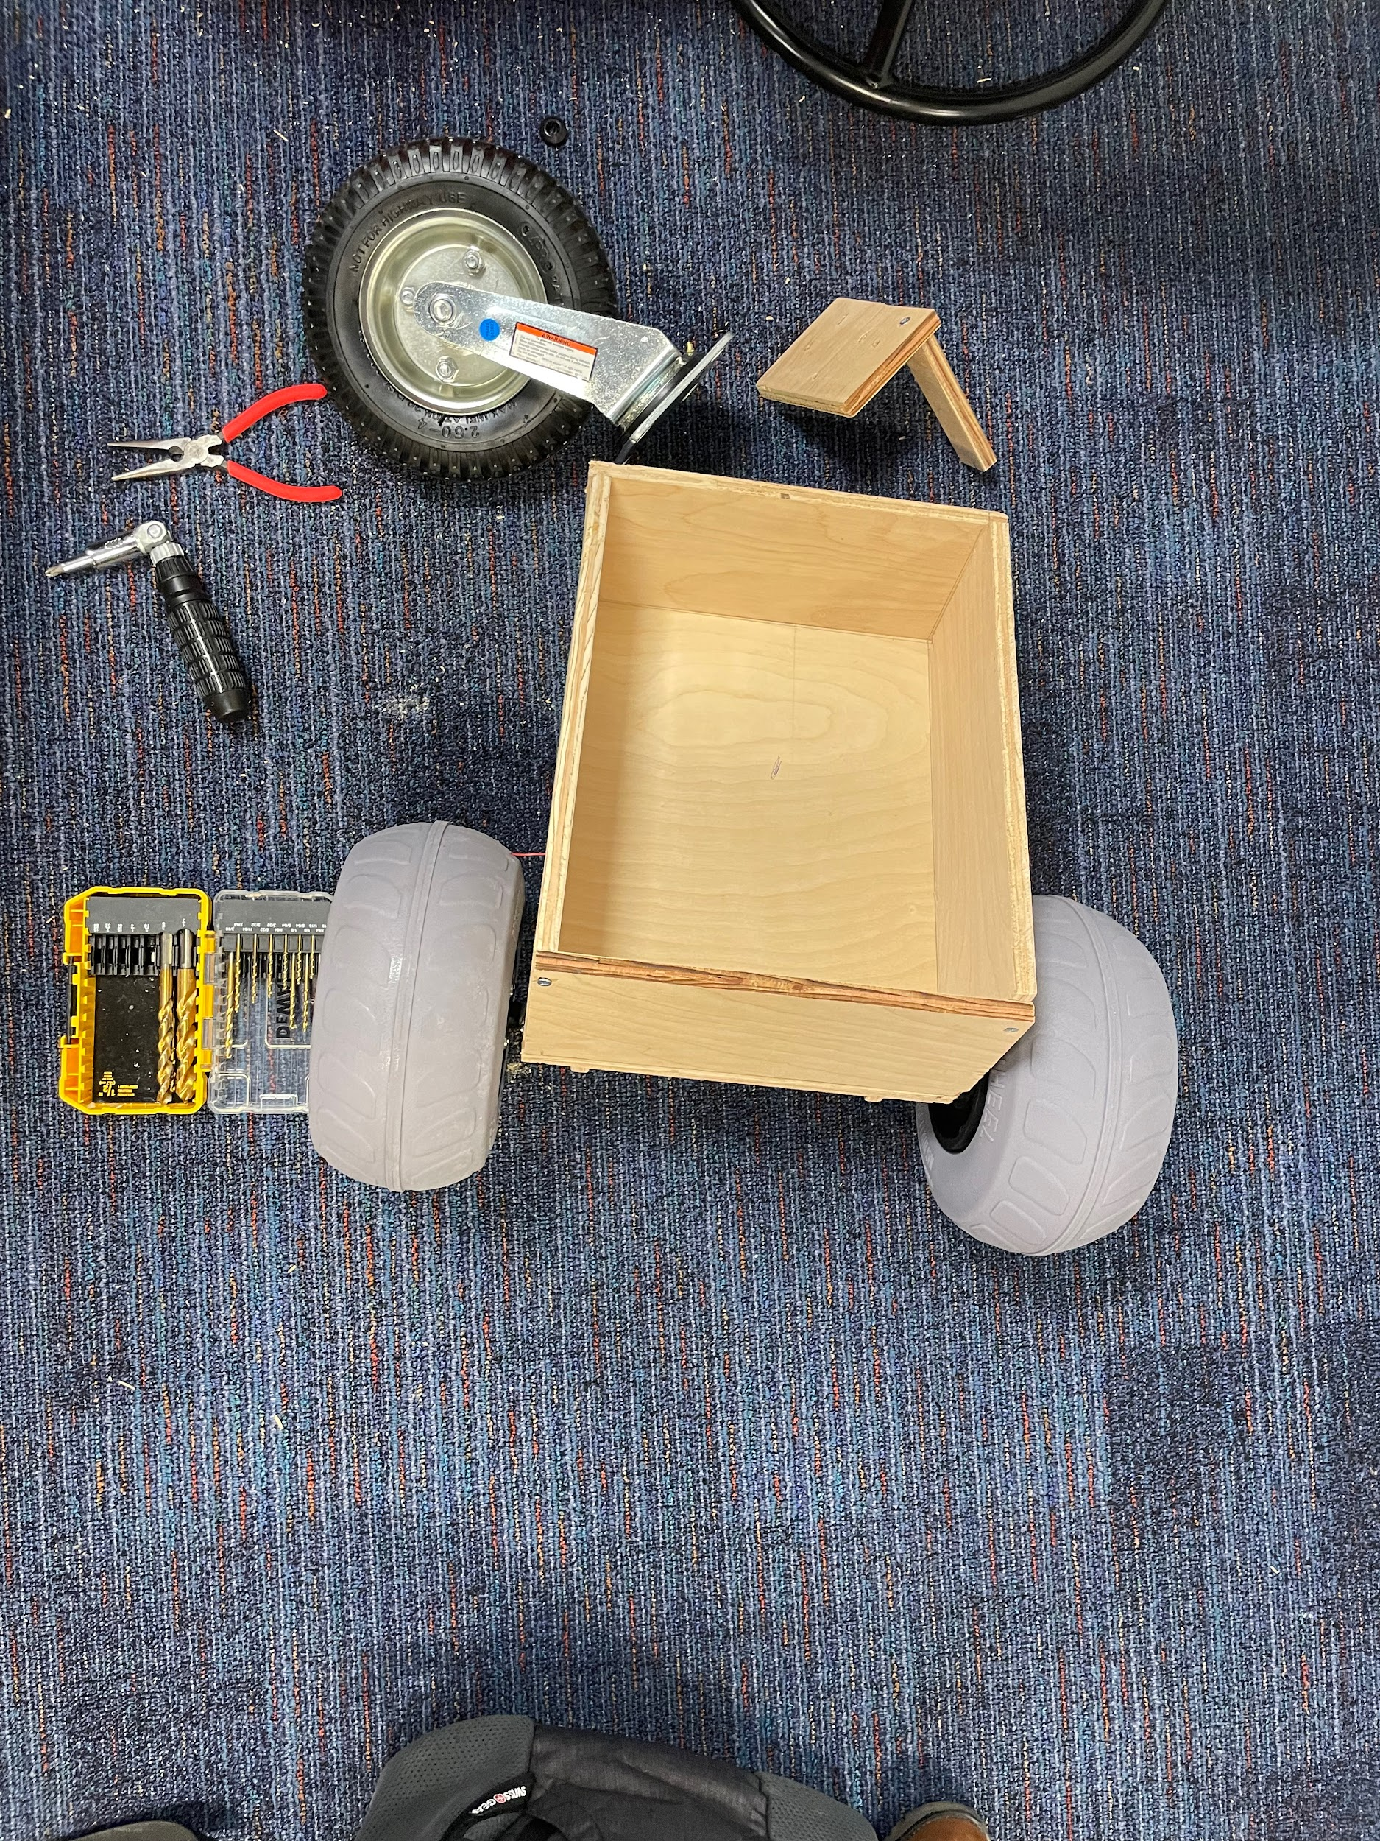
Chassis
Materials:
½ in x 2 ft x 4ft Sanded Plywood
1-½ in x ⅝ in Inside Corner Brace
8 x 1-½ in Wood Screws
9 in Balloon Beach Wheels
8 in Caster Wheel
⅜ in x 1-½ in Bolts
⅜ in Lock Nuts
⅜ in Washers
Notes:
Matt

Slide 17
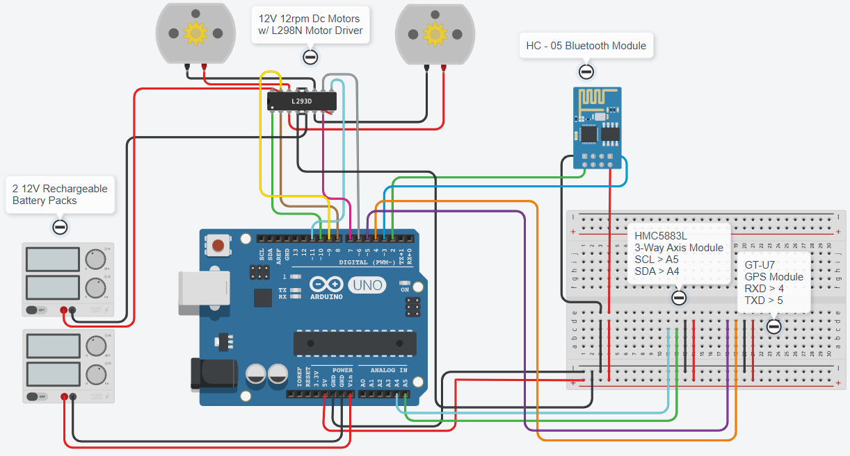
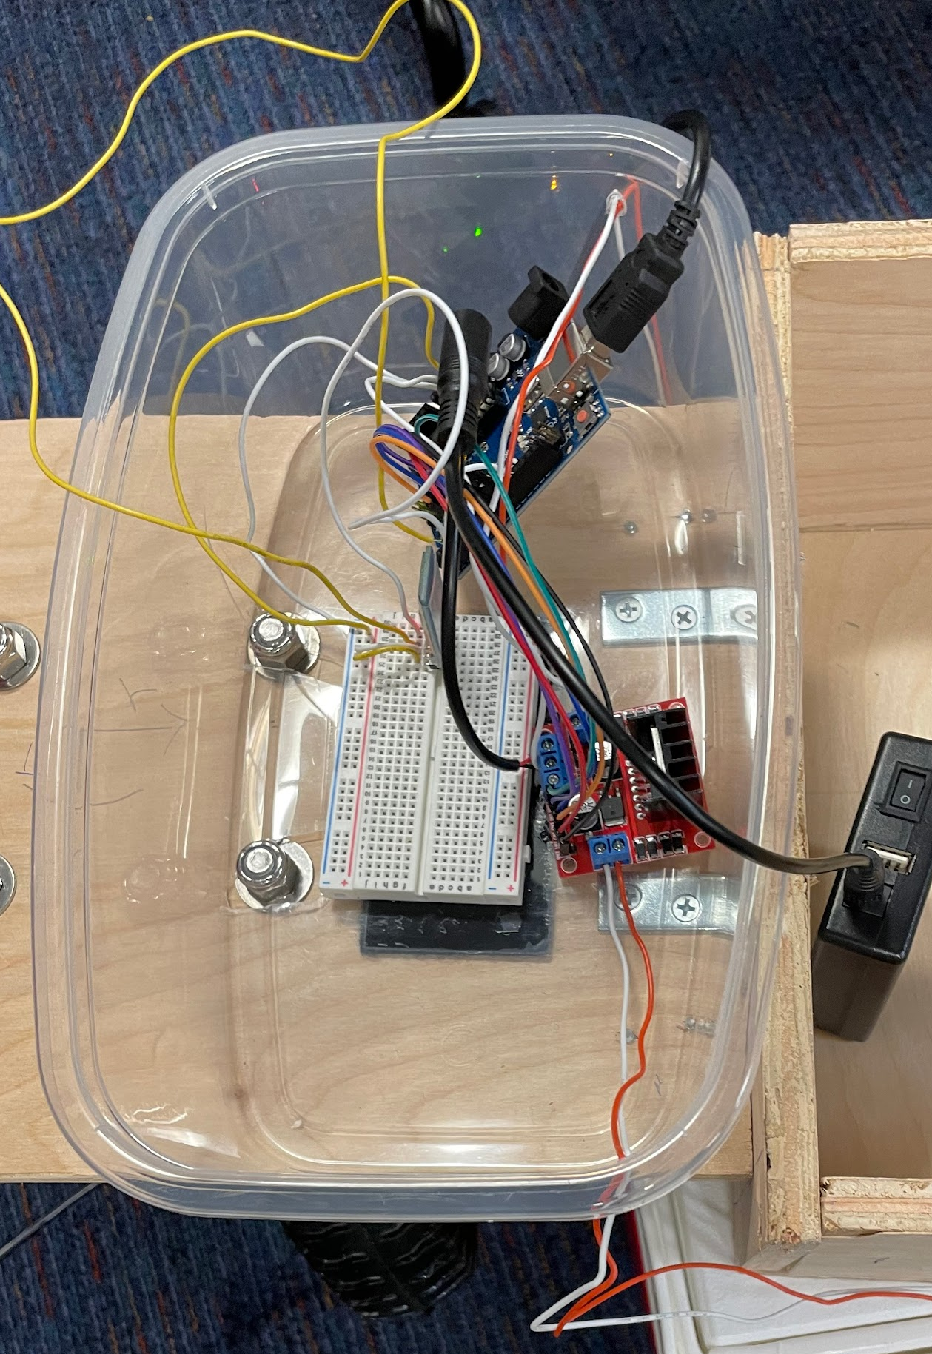
Wiring
Wire Diagram
Wire Housing
Notes:
Matt

Slide 18
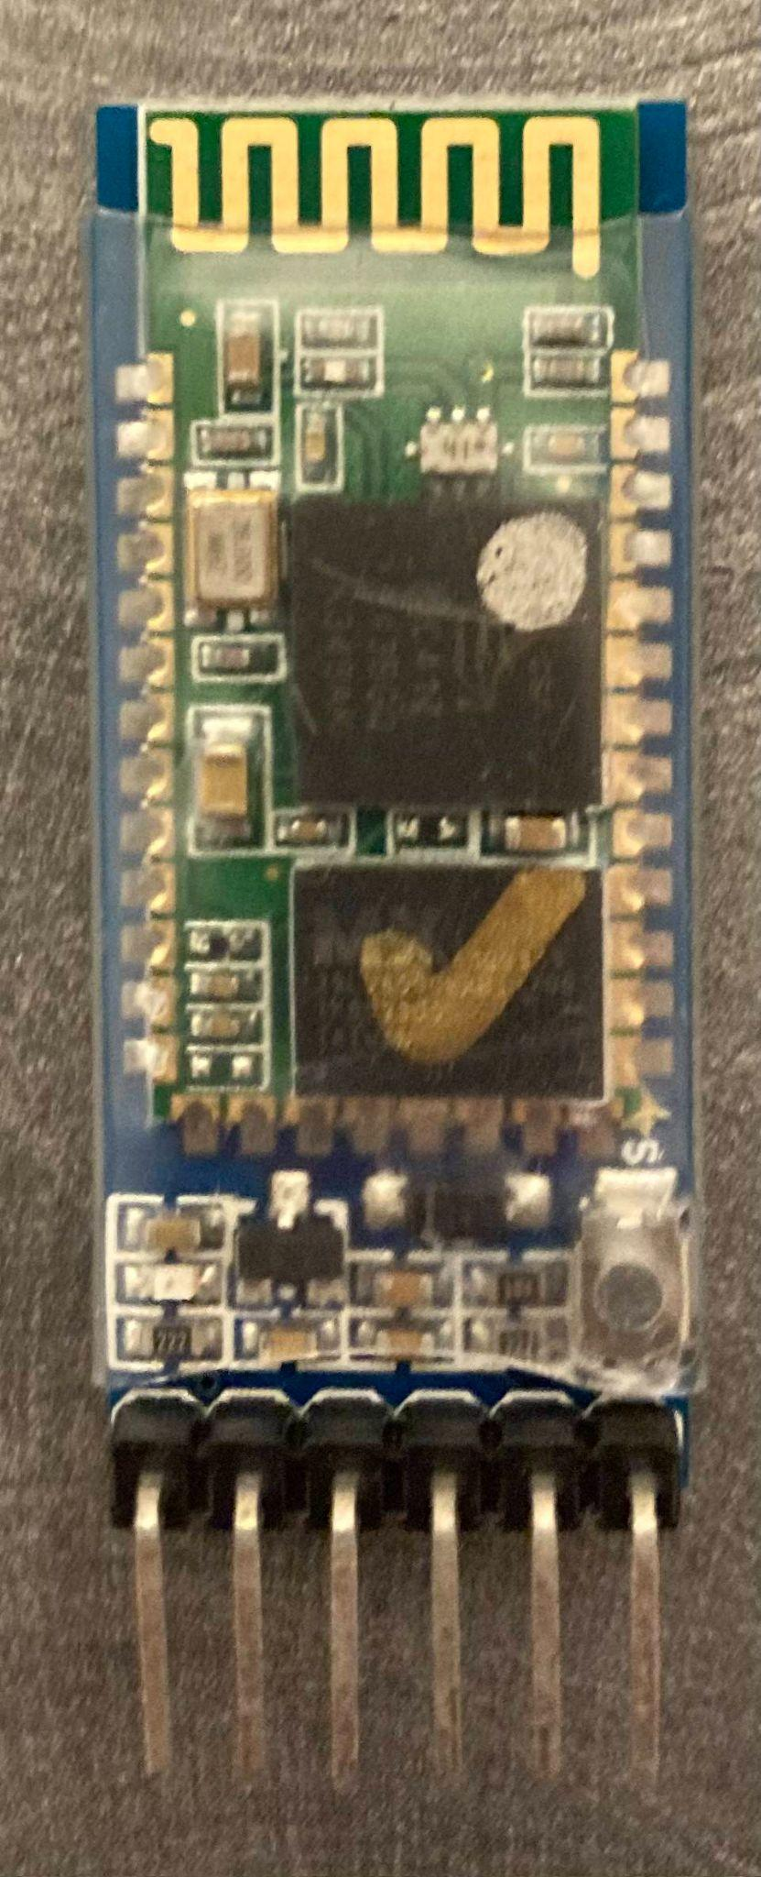
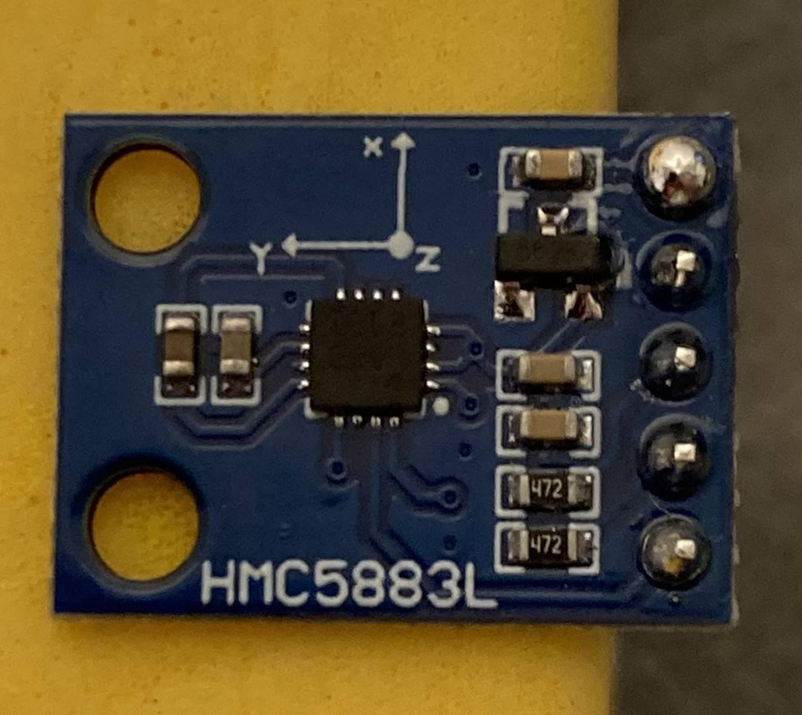

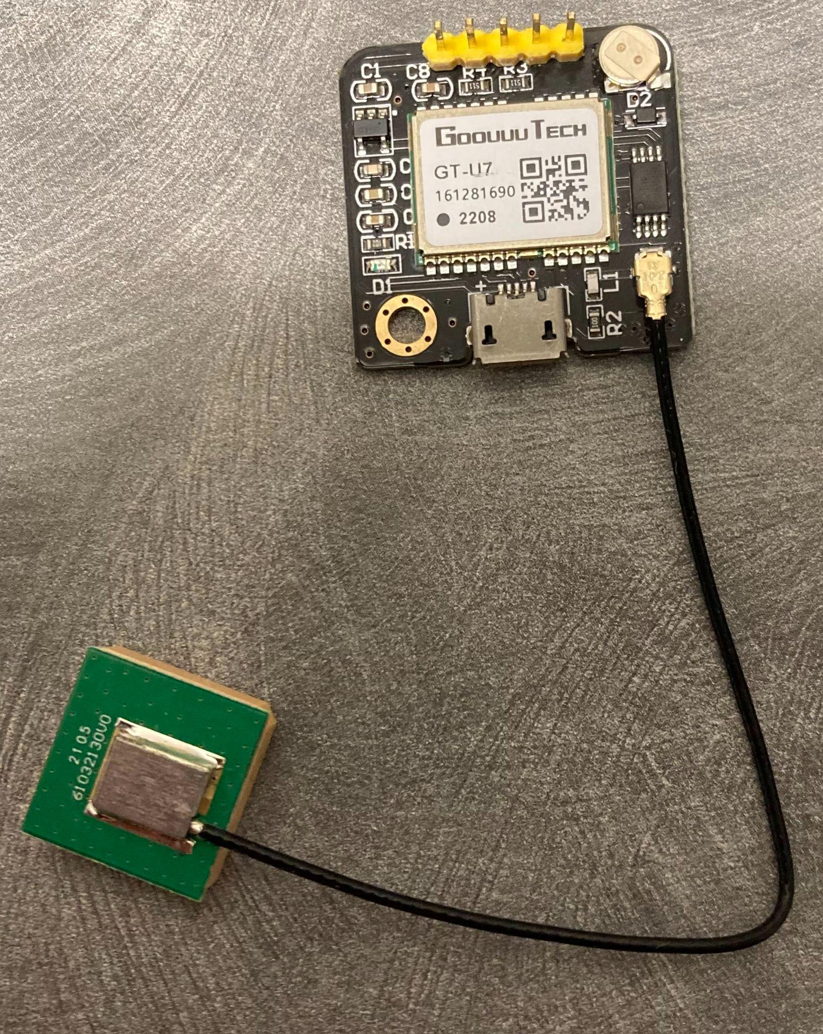
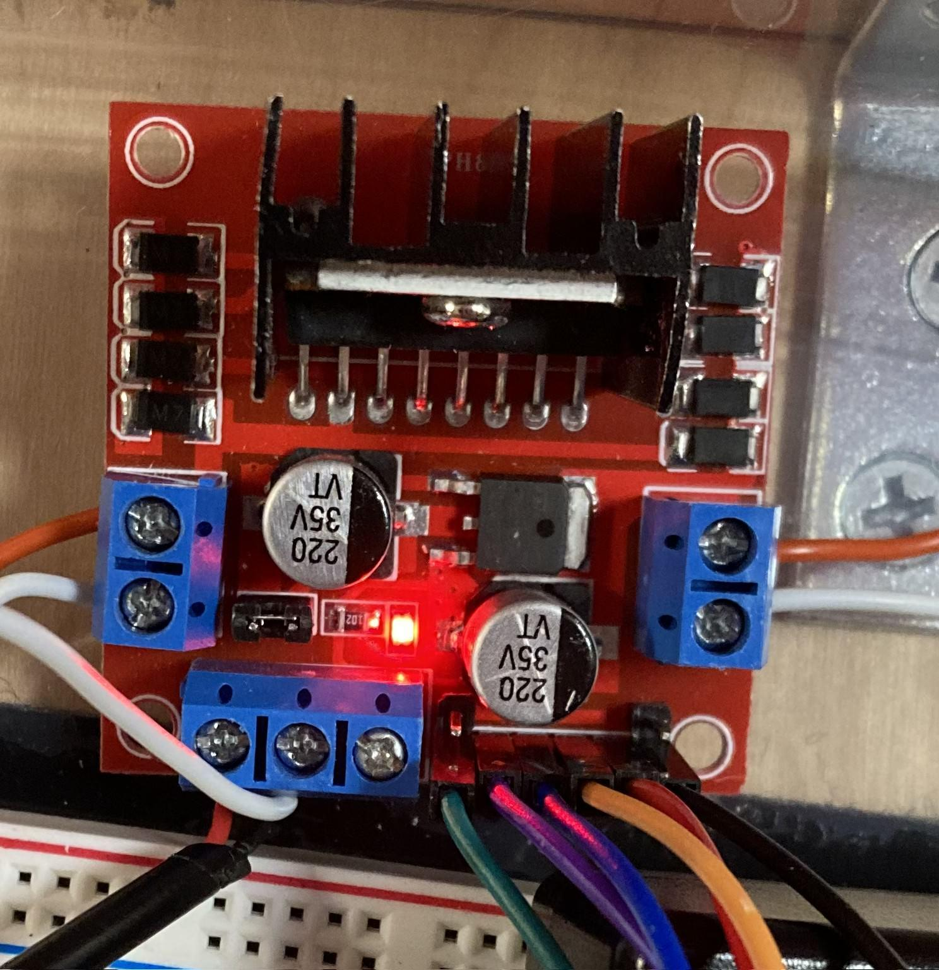
Arduino Modules
Bluetooth Module
Used for communication with the phone. Receives data via bluetooth v4.0.
GPS Module
Used for determining location of cooler.
Axis Module
Used to get orientation of cooler.
Motor Driver
Used to control motors which can change direction of cooler.
Notes:
Kai: Talk about purposes of 4 modules

Slide 19
Part 3. Testing/Troubleshooting
Notes:
Jovanni

Slide 20
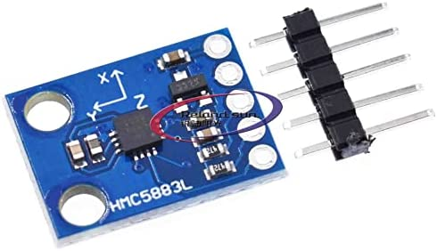
Axis Module Issues
Axis module provided inconsistent results on heading angle
Inconsistently off by 20 - 100 degrees
Tested 3 libraries
Multiple pin configurations
Adding/removing resistors
Inconsistent results
Notes:
How did we stumble onto this issue
What is the workaround we chose?
Jovanni

Slide 21
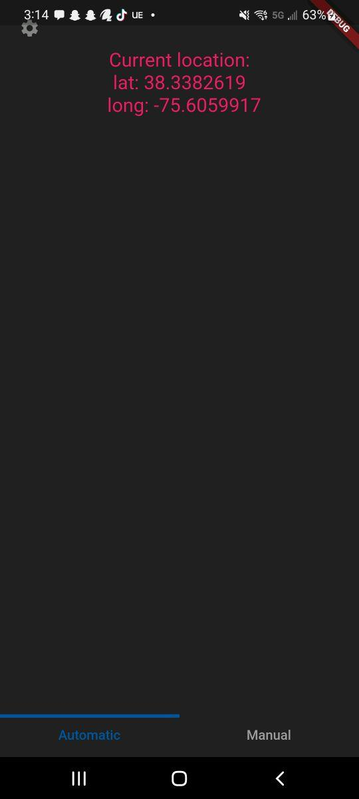
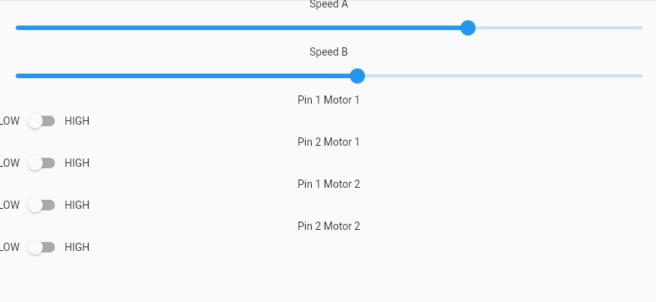
Application Issues
Completely scrapped
Notes:
Josh
The App apparently was a lofty goal as 90% of production time on the app was focused on getting bluetooth libraries to work
With the swapping of Bluetooth modules, switching between the Serial library and the BLE library combined with the lack of documentation on
the flutter_blue_plus library(the only library that we were able to get the phone and arduino to communicate) the app simply lacked functionality apart from its underdeveloped GUI

Slide 22
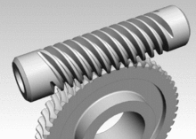
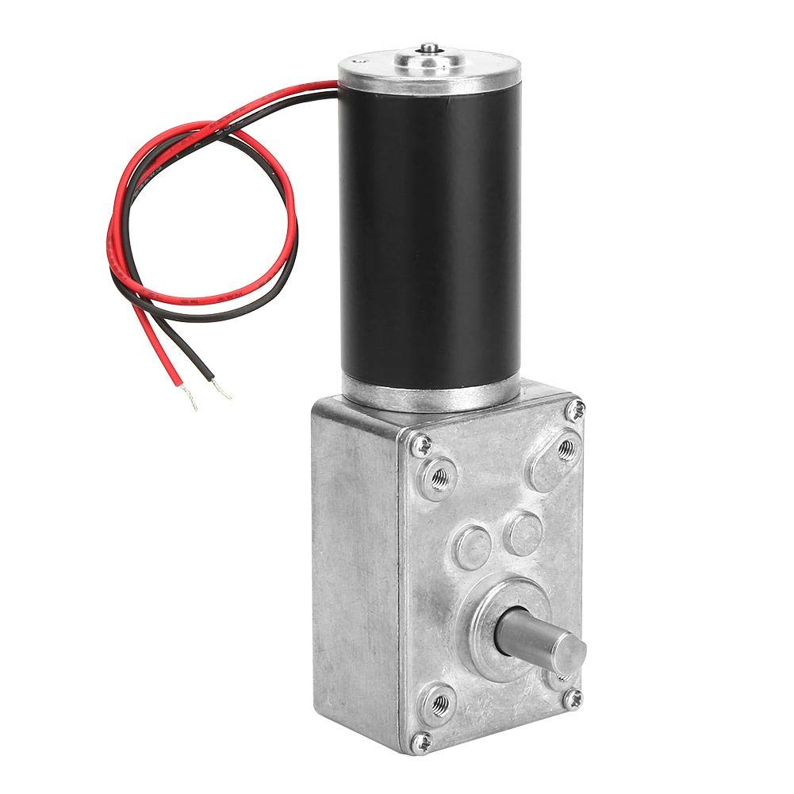
Motor Issues
Not enough RPM
Not enough torque for off roading
Worm motor
Notes:
The motors completely and utterly failed us.
The first motors that we got did not nearly have enough rpm to come close to walking speed
The second motors that we got allowed the robot to speed past walking speed, but would stall after mere seconds of use
The combination of these issues allow our final product to move at a snail's pace with little to no ambition

Slide 23
Part 4. Final Iteration

Slide 24
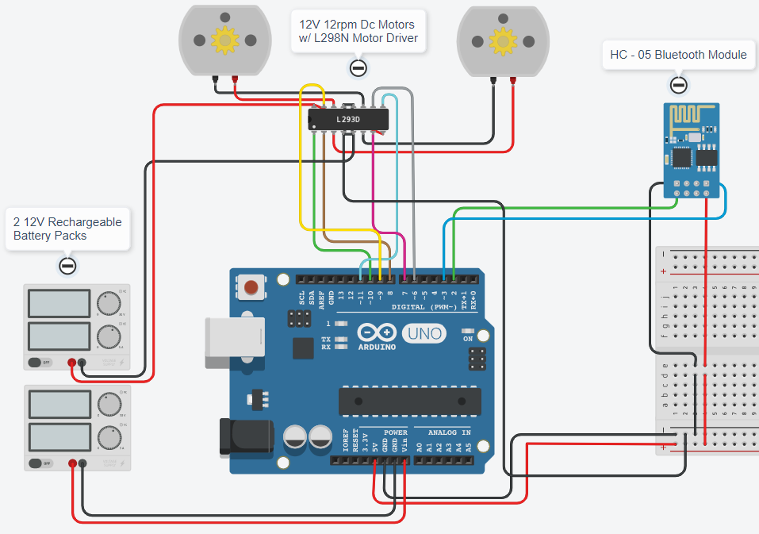
System Redesign
Redesigned system to work without the Axis module
Utilizes a control pad on the app, rather than automatic GPS coordinates being sent
Notes:
Kai
Reason
New design

Slide 25
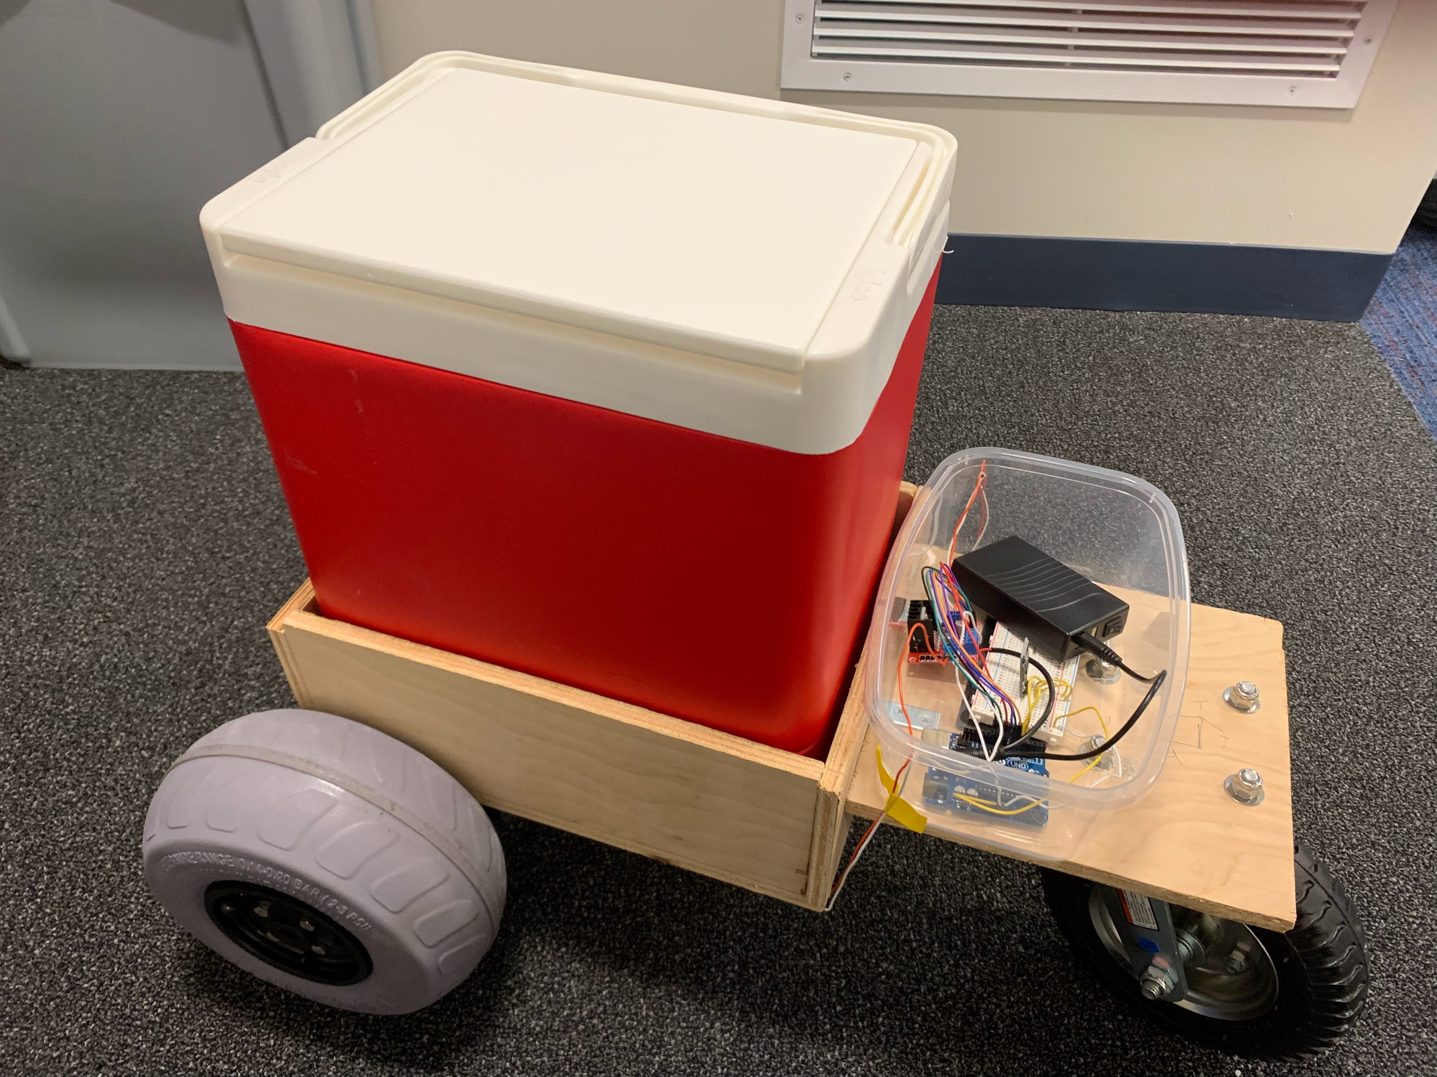
Final Assembly
Base
Electric Circuit Box
Motor
Beach Tires
Caster Wheel
Notes:
Kai

Slide 26
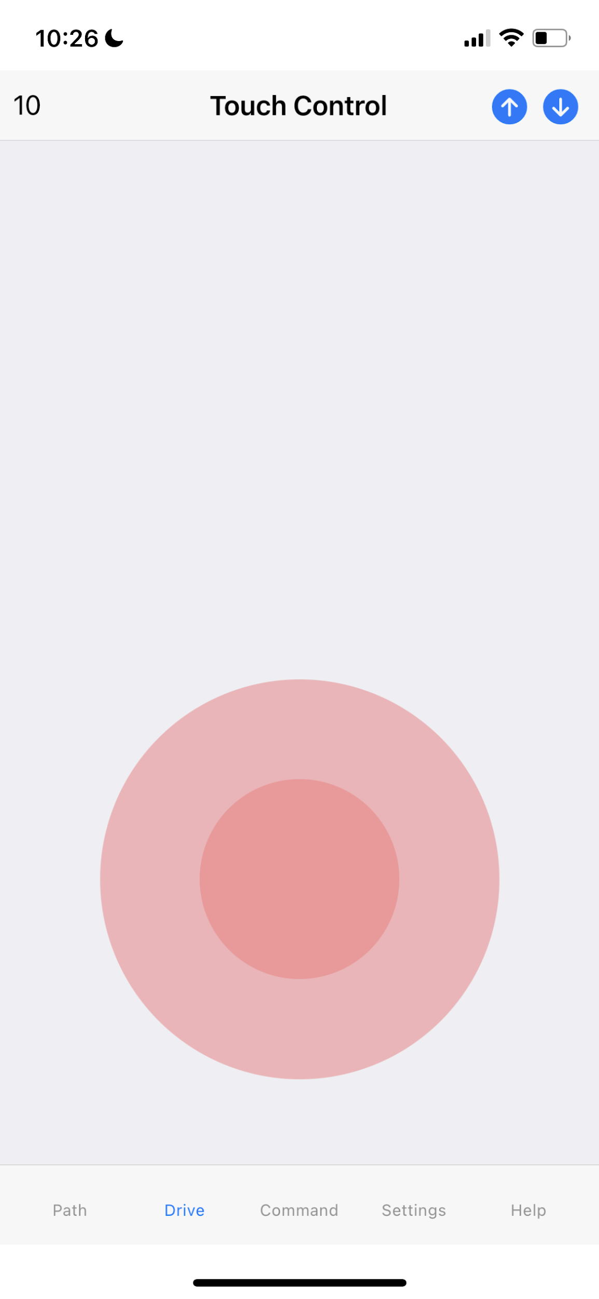
New Application - ArduinoBlue
ArduinoBlue is an easy to use iOS/Android application that allows Arduino control over bluetooth.
This app can be used to control your Arduino by sliders.
Notes:
Kai

Slide 27
Demo
Notes:
Matt

Slide 28
Thank you
Any questions?

Slide 29
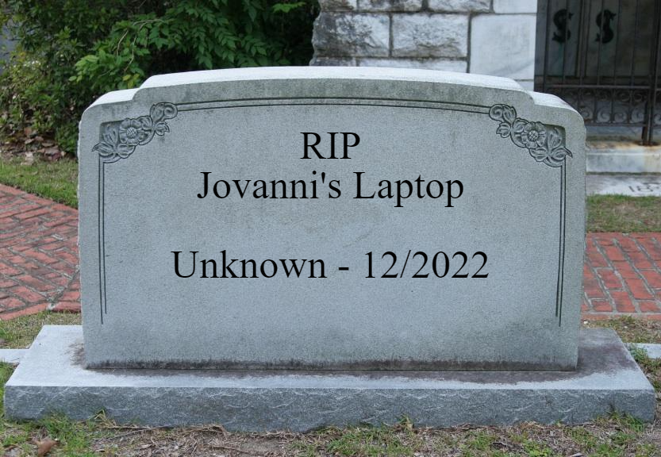
Moment of silence

